Slide 1
PLANT CELL WALLS
Alberto Echevarría-Poza
ae449@cam.ac.uk
PhD candidate in Biochemistry
Dupree lab - University of Cambridge
January 2023
Notes:
I do not own the images in the following slides. This presentation does not have any economic purpose. Likewise, this presentation does not pretend to be a state-of-the-art review on any topic related to the plant cell wall, but rather give a very broad view of what plant cell wall research entails. Many figures show remarkably simplified views of what they try to depict (in other words, they are inaccurate even at the moment of creating this presentation, but they have been chosen so for the sake of simplicity). Furthermore, the great variety in the cell wall has led to authors often naming structures in slightly different ways. Moreover, it would be impossible to show said great variety without getting lost in the details. Thus, not all existing cell wall structures are shown here unfortunately. If you are particularly interested in something you see, I would recommend you search for a recent review. I myself am happy to try to clarify, help solve any doubt, or recommend further reading with my modest knowledge. Send me an email at alberto.echevarriapoza@gmail.com Thank you for your time to read these lines!

Slide 2
THE IMPORTANCE OF THE PLANT CELL WALL
CO₂
Have a look at the notes below if you would like to read an explanation for the slides!
Notes:
Plants use light to fix CO₂ in the atmosphere and make organic molecules.

Slide 3
THE IMPORTANCE OF THE PLANT CELL WALL
CO₂
Notes:
Plants are then (sadly) eaten by other organisms, which are likewise eaten by other organisms. Eventually, even the strongest of the organisms die, and their remains are degraded by microorganisms. These microorganisms also yield inorganic nutrients for the plants to continue to fix more atmospheric CO₂ and pass organic carbon through the trophic chain again (I agree – it is plants farming us and not the other way round).

Slide 4
THE IMPORTANCE OF THE PLANT CELL WALL
CO₂
What percentage of the carbon in the biosphere accounts for plants?
Notes:
Now, stop for a minute and think what percentage of the organic carbon across all living organisms remains in plants.

Slide 5
THE IMPORTANCE OF THE PLANT CELL WALL
>80%
CO₂
Bar-on et al., 2018
Notes:
Ready to know the answer? It is above 80% [1]! Stunning, don’t you think?
[1] Bar-On, Y. M., Phillips, R., & Milo, R. (2018). The biomass distribution on Earth. Proceedings of the National Academy of Sciences, 115, 6506-6511.

Slide 6
Notes:
Hold on, but, what does that 80% mean? How many plants is that? OK, take a look at this computer-generated image of our beautiful galaxy. Any idea about how many stars there could be? Astronomists believe that the number should be between 100-400 billion stars (1-4x10¹¹) [1]. And how does this relate to our plants? 100-400 billion stars is such a ridiculously big number that is even difficult to picture it in our minds. Fine, let me tell you then that trees on our planet are so abundant that they dwarf the amount of stars in our galaxy: we estimate that we enjoy the presence of over three trillion trees (3x10¹²) on Earth! [2]. This means that there are around 375 trees per person in the world!
[1] https://asd.gsfc.nasa.gov/blueshift/index.php/2015/07/22/how-many-stars-in-the-milky-way/ (checked on 09/January/2023)
[2] Crowther, T. W., Glick, H. B., Covey, K. R., Bettigole, C., Maynard, D. S., Thomas, S. M., ... & Bradford, M. A. (2015). Mapping tree density at a global scale. Nature, 525, 201-205.

Slide 7
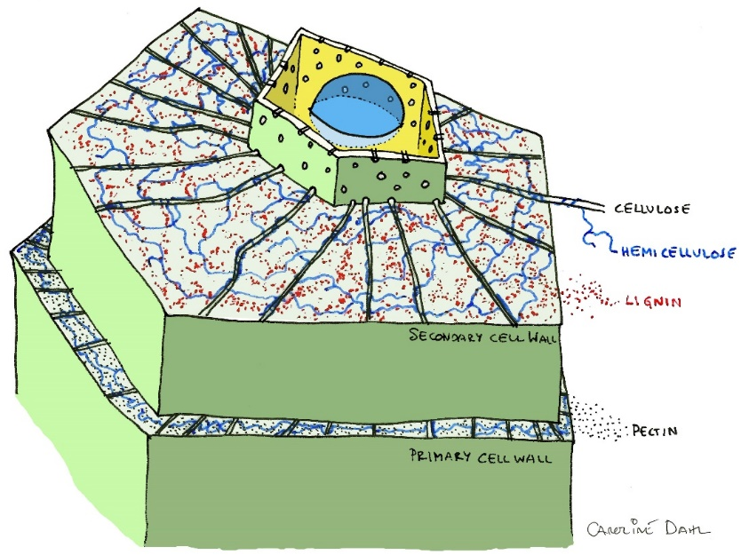
THE IMPORTANCE OF THE PLANT CELL WALL
>80%
CO₂
THE PLANT CELL WALL
Bar-on et al., 2018
>90% of the plant dry weight
Notes:
Let’s come back to the carbon in plants. We said a little more than 80% of all the carbon in the biosphere lies in plants. If we consider the dry weight of a plant (water does not have any carbon), an amazing 90-95% of it is plant cell wall! This material is what makes plants the way we know them: the trunk, the roots, the leaves… even if they look different, it is mostly the plant cell wall (and water) what we see all the time. So, what is the plant cell wall then? The plant cell wall is a rigid structure surrounding plant cells outside the plasma membrane and that serves structural, developmental, and signalling functions. The plant cell wall is mostly composed of polysaccharides, with the presence of some proteins and aromatic compounds too.

Slide 8
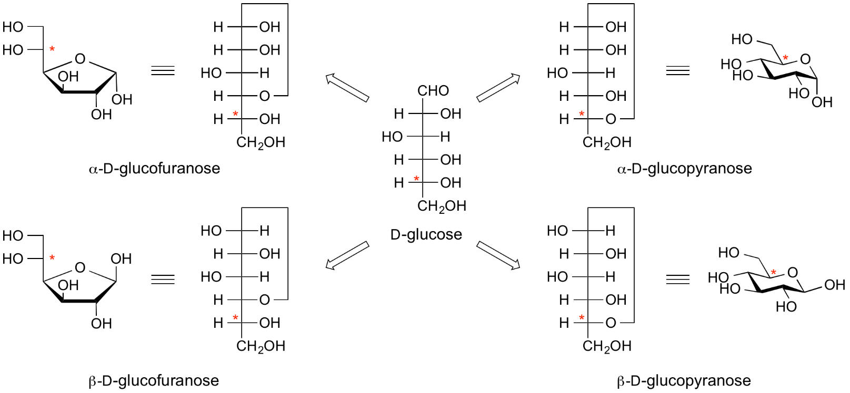
SUGARS MAKE UP MOST OF THE CELL WALL
6
6
5
4
1
5
2
4
2
1
3
1
3
2
3
4
5
6
Adapted from cazypedia.org
Notes:
Without losing track of the bigger picture, let’s have a quick look at the basics: polysaccharides are chains of monosaccharides, scientifically known as polyhydroxy aldehydes or ketones, in other words, sugars. These compounds can exist as either straight-chains or as rings (like in the cell wall). These rings can adopt five (furanose) or six member (pyranose) configurations. It is noteworthy that one of the members in the ring is an oxygen atom instead of a carbon atom, and the five or six member configuration does not relate to the amount of carbon atoms in the sugar. Pyranoses adopt a ‘chair’ conformation, whereas furanoses follow a ‘puckered’ conformation. Hydroxyl groups in a ring can be in either an axial (above/below the ring) or an equatorial (coming out from the ring) position. Carbon 1 (the anomeric carbon) is particularly important because it is the one that can be linked to other molecules, and, it leads to α (hydroxyl in axial position) and β (equatorial) anomers. Without getting lost in the details, sugars are also designated D or L (imagine a sugar as a straight-chain instead of as a ring, look at the penultimate carbon (denoted with a red asterisk in this figure), and check if its three largest substituents increase in size clockwise (D) or counter clockwise (L)). Numbers in green show how carbon atoms are numbered in sugars.

Slide 9
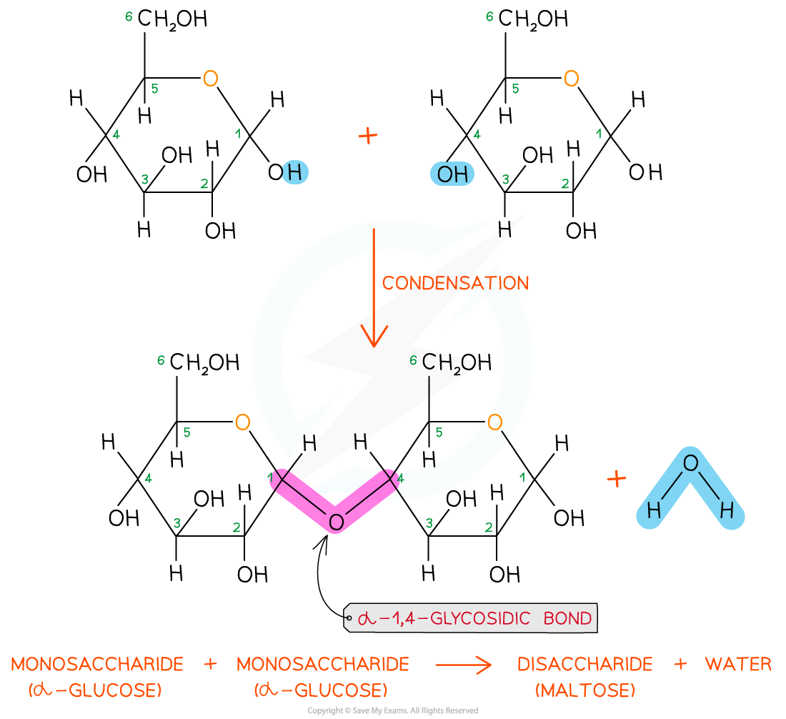
MAKING SUGAR CHAINS
savemyexams.co.uk
Notes:
When sugars form oligo- or polysaccharides, this occurs mostly by O-glycosidic bonds: the hydroxyl of Carbon 1 reacts with a hydroxyl (other than that of carbon 1) in another sugar, sugars get bonded through an oxygen atom, and a water molecule is released.
https://www.savemyexams.co.uk/a-level/biology/cie/22/revision-notes/2-biological-molecules/2-2-carbohydrates--lipids/2-2-4-the-glycosidic-bond/ (Checked on 10/January/2023)

Slide 10
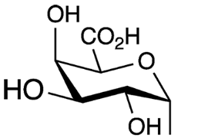
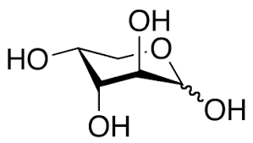
MANY SUGARS!
4
6
5
2
v
1
3
v
4
1
5
2
3
arabinofuranose (Araf)
arabinopyranose (Arap)
Notes:
These are some of the most abundant sugars found in plant cell wall polysaccharides. Some are hexoses (6 carbon atoms) and some are pentoses (5 carbon atoms).
All things considered, it becomes simple to make a new sugar just by, say, changing the conformation of a single hydroxyl from equatorial to axial. In fact, that is what happens, and the new sugar is often not recognised by most of the proteins anymore. For instance, note how the only difference between glucose and galactose is that the hydroxyl in carbon 4 is in an axial position in galactose, or the hydroxyl in carbon 2 when comparing glucose and mannose. Hydroxyl in carbon 1 is shown with a wavy bond not to show either the α (axial) or the β (equatorial) conformations.
Interestingly, arabinose can appear in cell wall polysaccharides as a furanose or a pyranose.
Numbers in green show how carbon atoms are numbered in sugars.

Slide 11
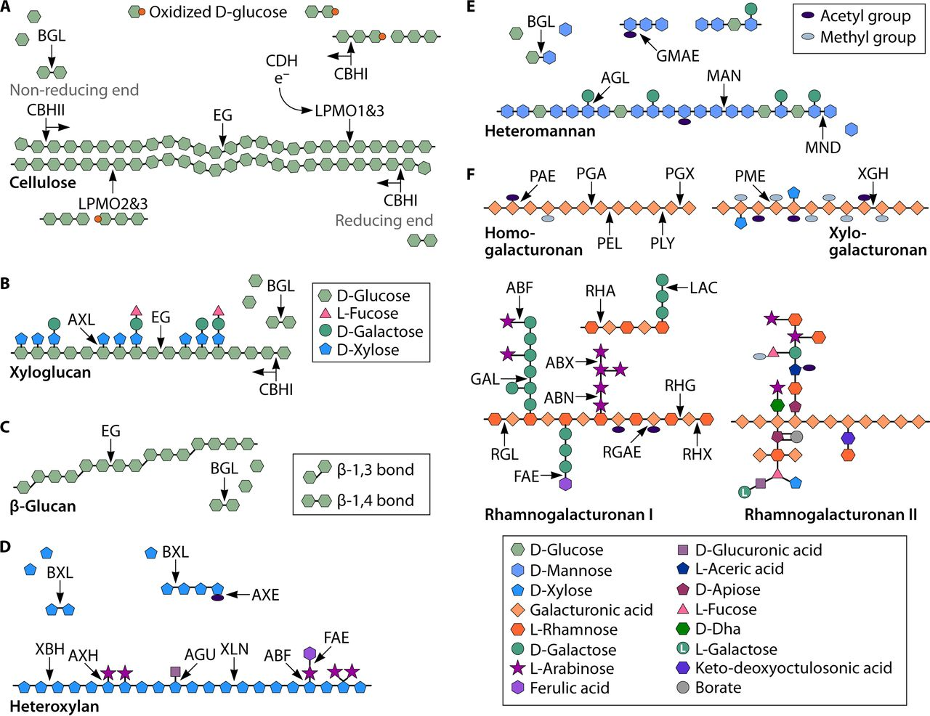
POLYMERS
Cellulose
Xylan
Mannan
Xyloglucan
Pectins
Homogalacturonan
Rhamnogalacturonan I
Rhamnogalacturonan II
Callose
Mixed linkage β-glucan
Arabinogalactan proteins
Structural proteins
Lignin
Rytioja et al., 2014
Notes:
Such a big array of sugar possibilities (and how many different carbons they can choose to bind) is translated into many different polysaccharides forming the plant cell wall. These can be classified into three main groups: cellulose, hemicelluloses, and pectins, although some other polysaccharides exist too. For now, you are suggested not to check with too much detail the figure here since it only aims at displaying the rich sugar variety in cell wall polysaccharides at a glance.
Rytioja, J., Hildén, K., Yuzon, J., Hatakka, A., De Vries, R. P., & Mäkelä, M. R. (2014). Plant-polysaccharide-degrading enzymes from basidiomycetes. Microbiology and Molecular Biology Reviews, 78, 614-649.

Slide 12
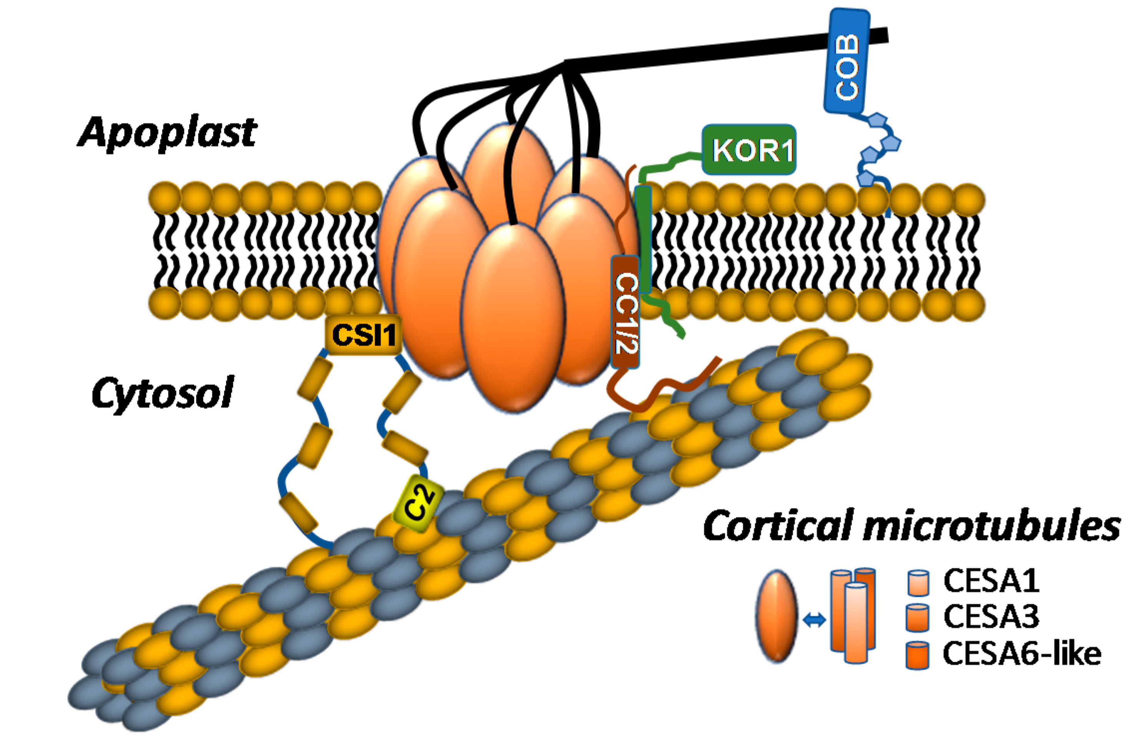
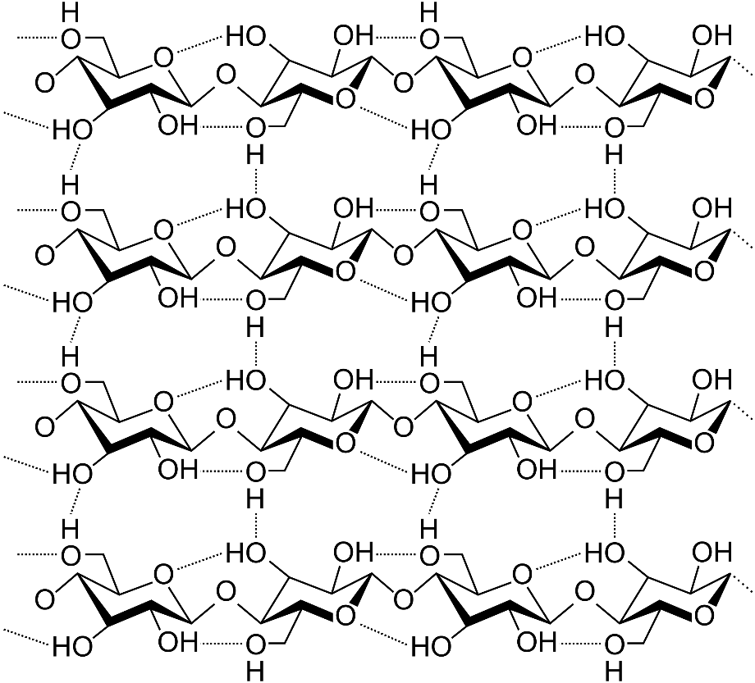
CELLULOSE
Speicher et al., 2018
Notes:
Cellulose forms the main blocks that make up the plant cell wall. This is a linear chain of glucose with 1β→4 linkages and is the most abundant polysaccharide on earth. Despite being a linear chain, cellulose actually appears as a stack of 18 chains (18 is just the number that experts find the most plausible). Unlike the rest of the cell wall polysaccharides, cellulose is synthesised directly at the plasma membrane, with nascent cellulose chains already coming out at the cell wall. To that end, cellulose synthases (CESAs) form rosette-like structures at the plasma membrane: CESAs form trimers, and then the rosette is packed with six trimers (a hexamer of trimers for 18 CESAs in total). In this image, a single chain comes out of each of the monomers forming the hexamer, yet, in theory, three cellulose chains come out of each of those six trimers (when the individual cellulose chains coalesce and stack is poorly understood). In addition, many other complimentary proteins with poorly characterised functions regulate cellulose synthesis (like KOR1 in this image). CESAs are sometimes found bound to microtubules, which regulate the places for cellulose synthesis.
Speicher, T. L., Li, P. Z., & Wallace, I. S. (2018). Phosphoregulation of the plant cellulose synthase complex and cellulose synthase-like proteins. Plants, 7, 52.

Slide 13
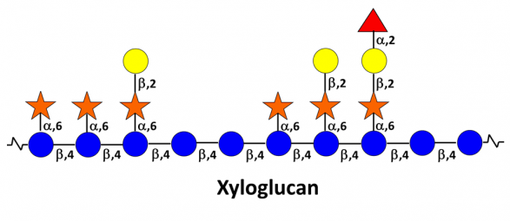
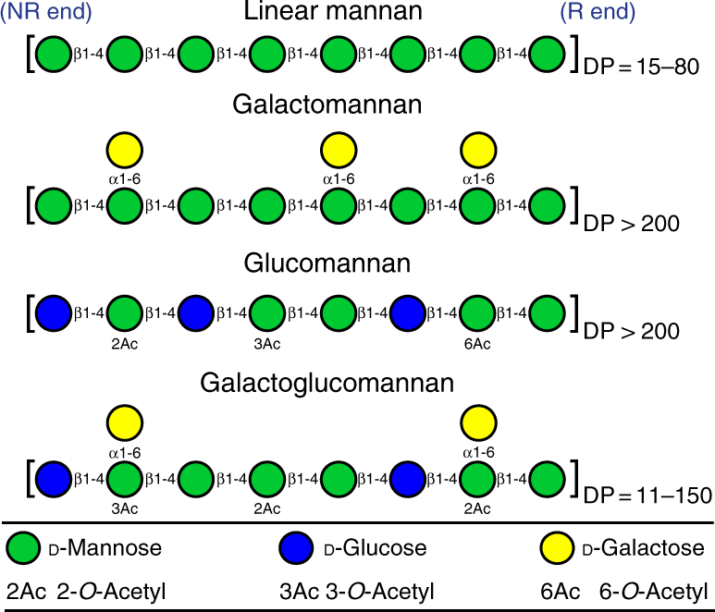
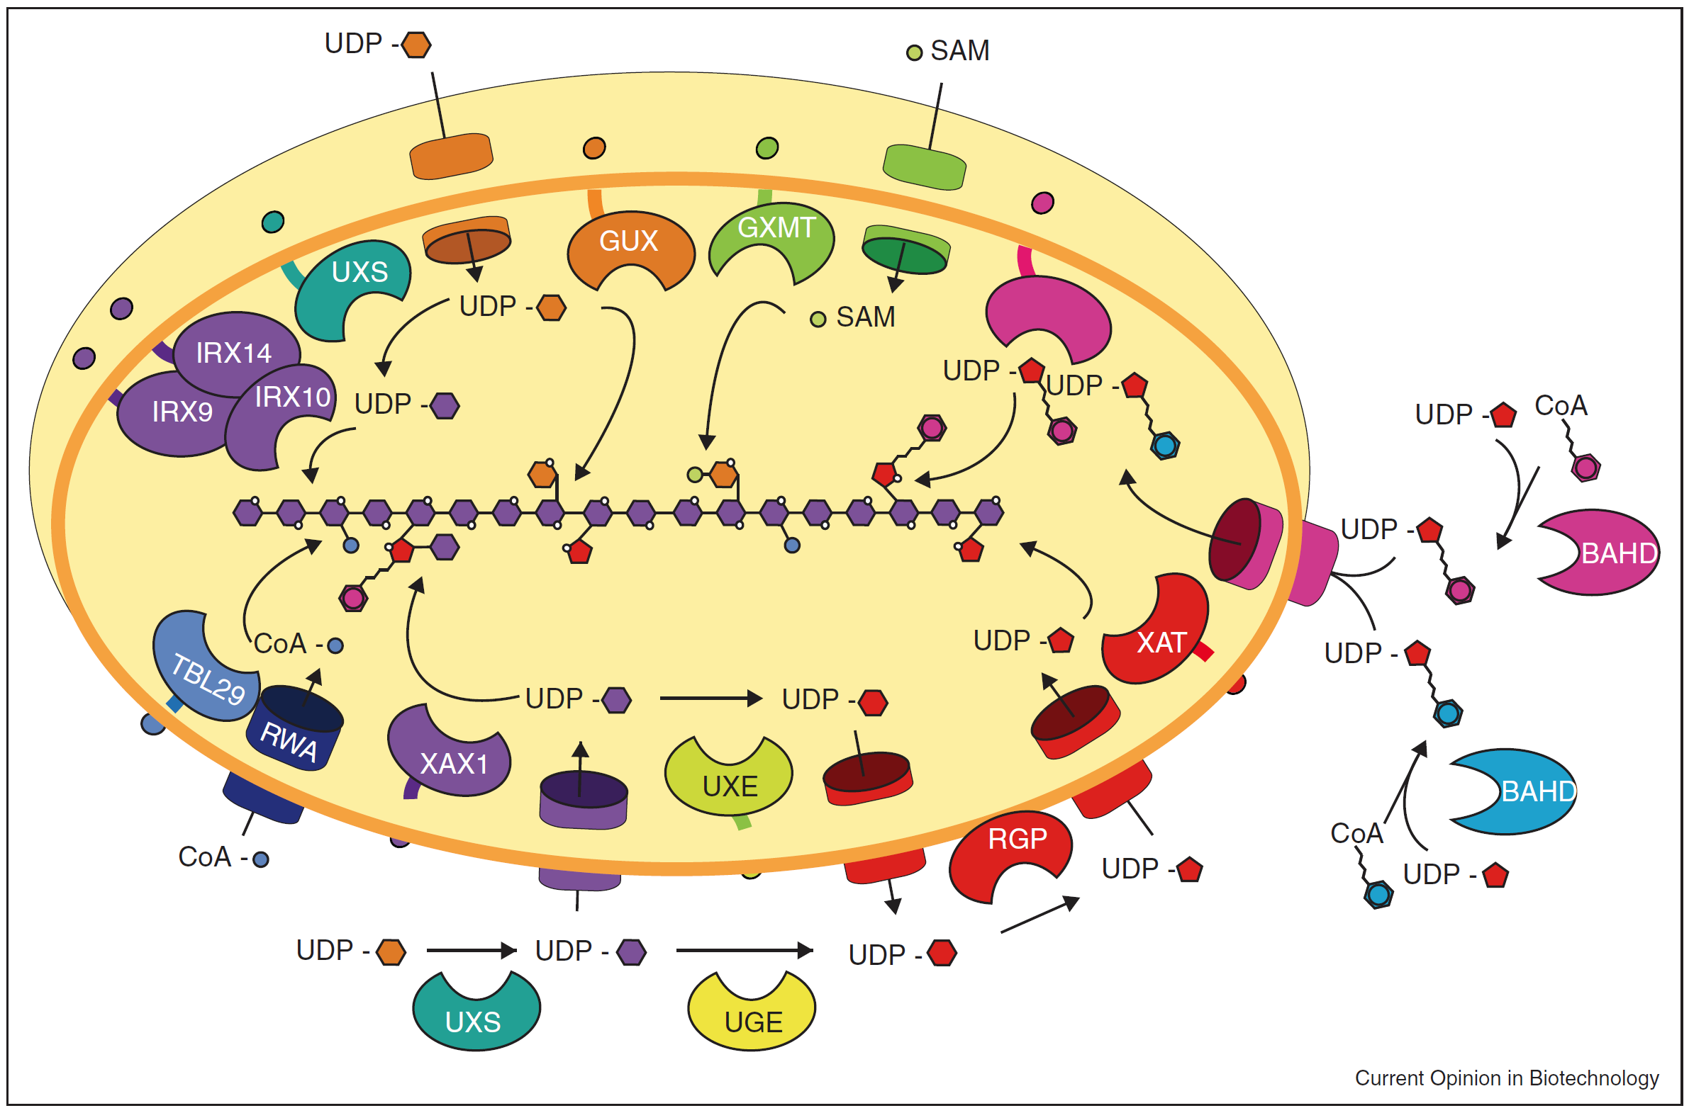
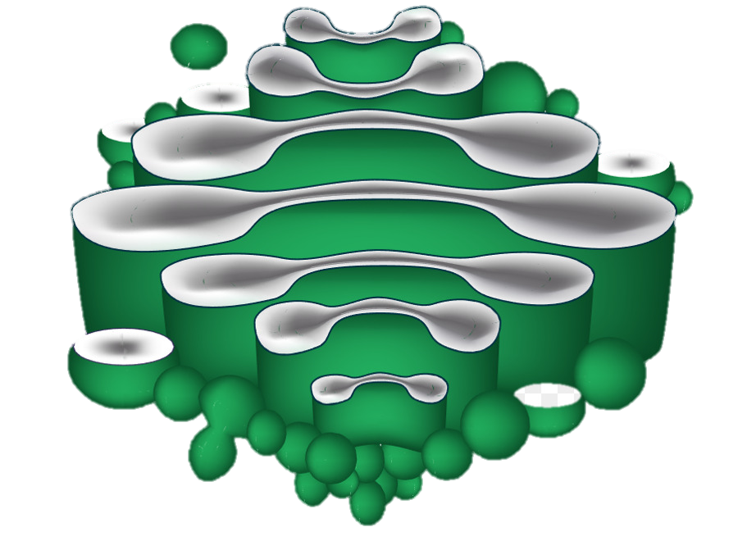
HEMICELLULOSES
Adapted from La Rosa et al., 2019
Glycopedia.eu
Xylan
Adapted from Smith et al., 2017
Golgi stacks
Golgi cisterna
Adapted from Rennie & Scheller (2014)
Notes:
Hemicelluloses are a group of varied polysaccharides that coat and crosslink cellulose. These mainly comprise xylan, xyloglucan, and mannan. Most cell wall polysaccharides are named after the sugars that form them: xylan after xylose, xyloglucan after xylose and glucose, and mannan after mannose However, they can be formed by more sugars than those in their names, or rather, have longer names: xylan/arabinoxylan/glucuronoxylan/glucuronoarabinoxylan or mannan/glucomannan/galactomannan/galactoglucomannan (sometimes also heteroxylan or heteromannan names can be spotted). Unlike cellulose, hemicelluloses do not form stacks. However, their main chain (backbone) can have short branches (decorations or substitutions) that modulate their solubility and ability to bind cellulose at different regions. These substitutions increase the variety of cell wall polymers, since they often differ across plant taxa and tissues. Hemicelluloses and all other non-cellulosic cell wall polysaccharides are synthesised in the Golgi apparatus and later secreted to the cell wall. In fact, hemicellulose deposition and cellulose synthesis are finely coordinated by yet-to-be-discovered mechanisms. The image in the bottom right corner shows how the synthesis of xylan could potentially be taking place by sequential action of many proteins in a Golgi cisterna. Particularly, hemicellulose and pectin synthesis require the concerted action of many different proteins, each with a very specific activity. Discovery and functional characterisation of these proteins is a big area in plant cell wall research.
La Rosa, S. L., Leth, M. L., Michalak, L., Hansen, M. E., Pudlo, N. A., Glowacki, R., ... & Westereng, B. (2019). The human gut Firmicute Roseburia intestinalis is a primary degrader of dietary β-mannans. Nature communications, 10, 1-14.
Smith, P. J., Wang, H. T., York, W. S., Peña, M. J., & Urbanowicz, B. R. (2017). Designer biomass for next-generation biorefineries: leveraging recent insights into xylan structure and biosynthesis. Biotechnology for biofuels, 10, 1-14.
Rennie, E. A., & Scheller, H. V. (2014). Xylan biosynthesis. Current opinion in biotechnology, 26, 100-107.
https://www.glycopedia.eu/e-chapters/the-plant-cell-walls/article/secondary-wall-hemicelluloses (checked on 09/January/2023)

Slide 14
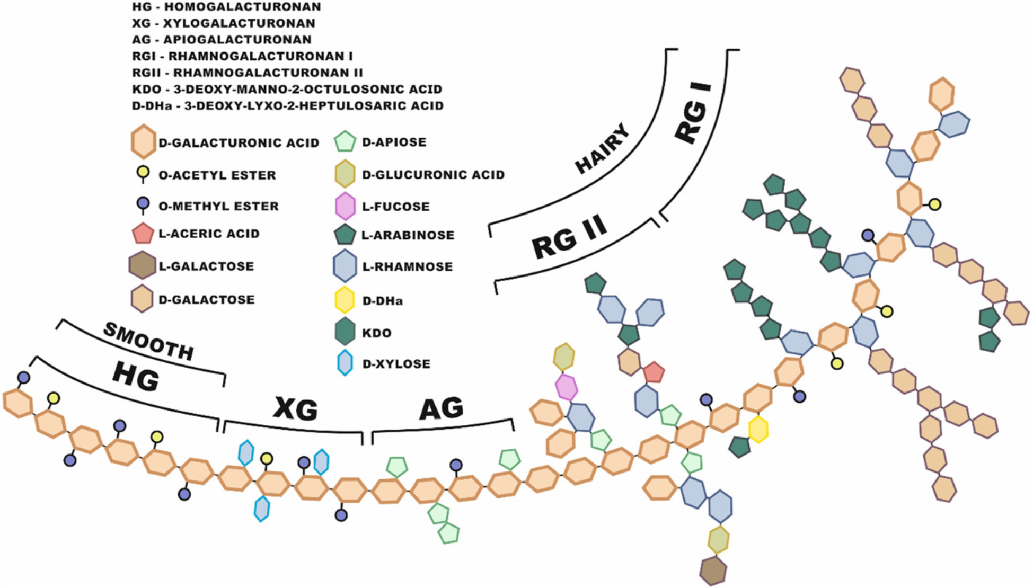
PECTINS
Adapted from Zdunek et al., 2021
Notes:
Pectins are another group of polysaccharides that form the cell wall matrix where cellulose and hemicelluloses are embedded. The most abundant (65%) pectin is homogalacturonan (HG): a linear chain of galacturonic acid residues. In very particular cases, homogalacturonan can have short branches of xylose (xylogalacturonan) or apiose (apiogalacturonan). Rhamnogalacturonan-I (RG-I), instead, alternates galacturonic acid and rhamnose in its backbone. Interestingly, rhamnose residues can carry long branches of other polysaccharides such as arabinans (composed of arabinose) or galactans (of galactose). RG-I makes up 35% of the pectins, and the 10% remaining comprises Rhamnogalacturonan-II (RG-II), a short backbone of galacturonic acid with many short branches that carry many types of sugars. It is noteworthy that the aforementioned types of pectins can be linked together (e.g. homogalacturonan bound to rhamnogalacturonan-I), although not with such short regions as in this picture with just illustrative purposes. Like hemicelluloses, pectins are synthesised in the Golgi apparatus and are then secreted to the cell wall. Pectin methylation is a particularly important modification. Methylation can occur in carbon 6 of galacturonic acid (the carboxyl group; have a look at the slide with the sugar if you need). Thus, unmethylated galacturonic acid is negatively charged and Ca²⁺ ions can mediate crosslinks to other unmethylated pectin regions. This is a way cell wall porosity can be controlled.
Zdunek, A., Pieczywek, P. M., & Cybulska, J. (2021). The primary, secondary, and structures of higher levels of pectin polysaccharides. Comprehensive Reviews in Food Science and Food Safety, 20, 1101-1117.

Slide 15
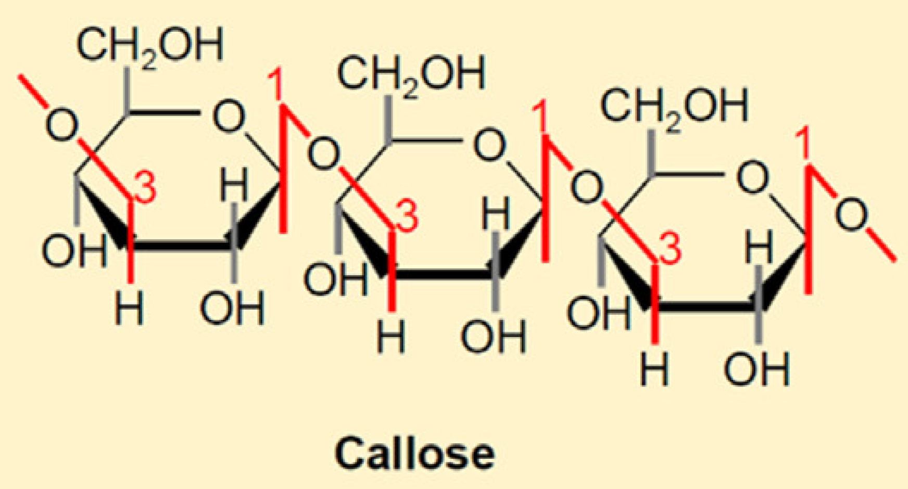
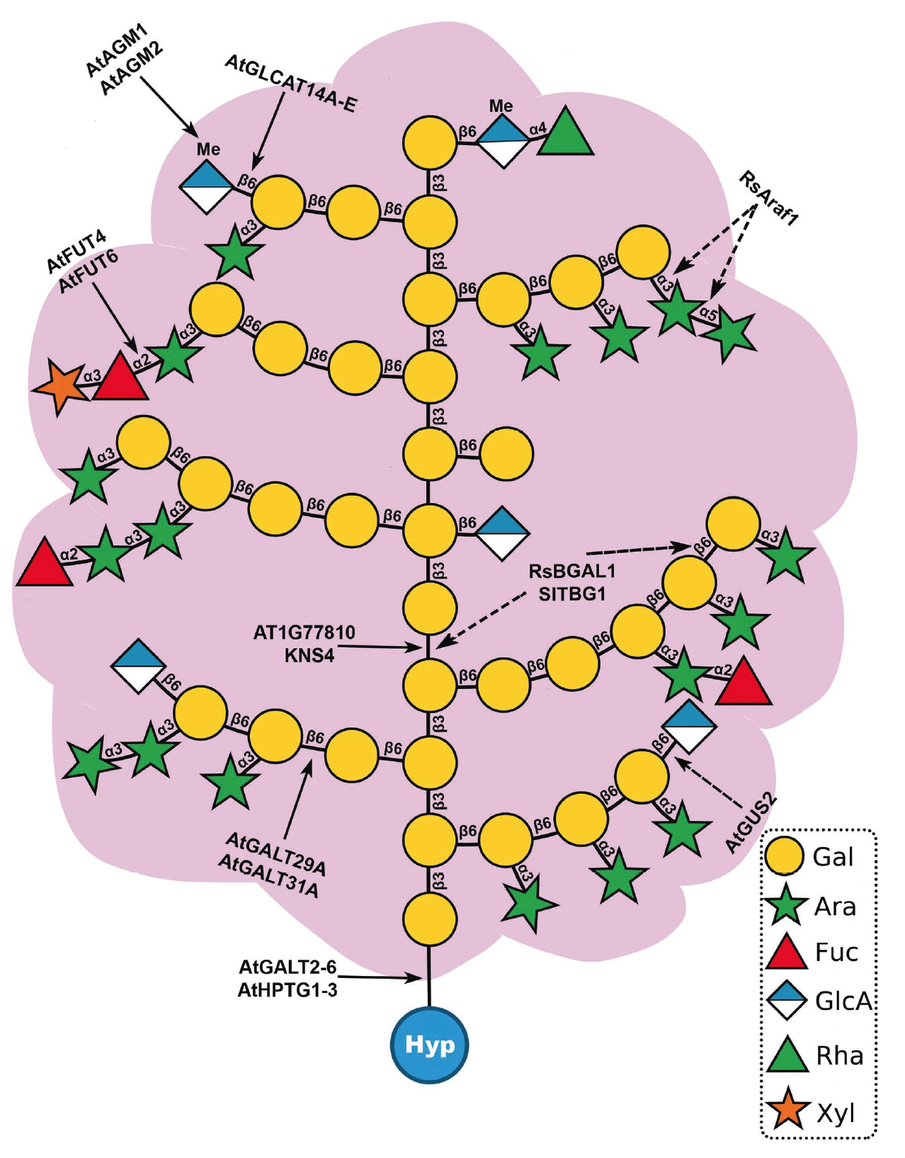
CALLOSE
ARABINOGALACTAN PROTEINS
Adapted from Wang et al., 2022
MIXED-LINKAGE GLUCAN
Red: their C4 hydroxyl gets linked
Blue: their C3 hydroxyl gets linked
Adapted from Dallabernardina, et al., 2017
Silva et al., 2020
Notes:
Still, some other polysaccharides can be found in the cell wall. For instance, callose is a linear glucose polymer, but, unlike in cellulose, residues are have1β→3 linkages. Callose appears in the division plate, after wounding, or during growth of the pollen tube. Another polysaccharide found mostly in grasses is the so-called mixed‐linkage (1→3),(1→4)‐β‐D‐glucans, composed of glucose alternating 1β→3 and 1β→4 bonds.
Despite not purely polysaccharides, some structural proteins are also essential for the plant cell wall and often also carry polysaccharides. A good example is arabinogalactan proteins, whose hydroxyprolines can carry highly branched galactan chains with further arabinose branches.
Wang, B., Andargie, M., & Fang, R. (2022). The function and biosynthesis of callose in high plants. Heliyon, e09248.
Dallabernardina, P., Schuhmacher, F., Seeberger, P. H., & Pfrengle, F. (2017). Mixed‐linkage glucan oligosaccharides produced by automated glycan assembly serve as tools to determine the substrate specificity of lichenase. Chemistry–A European Journal, 23, 3191-3196.
Silva, J., Ferraz, R., Dupree, P., Showalter, A. M., & Coimbra, S. (2020). Three decades of advances in arabinogalactan-protein biosynthesis. Frontiers in Plant Science, 11, 610377.

Slide 16
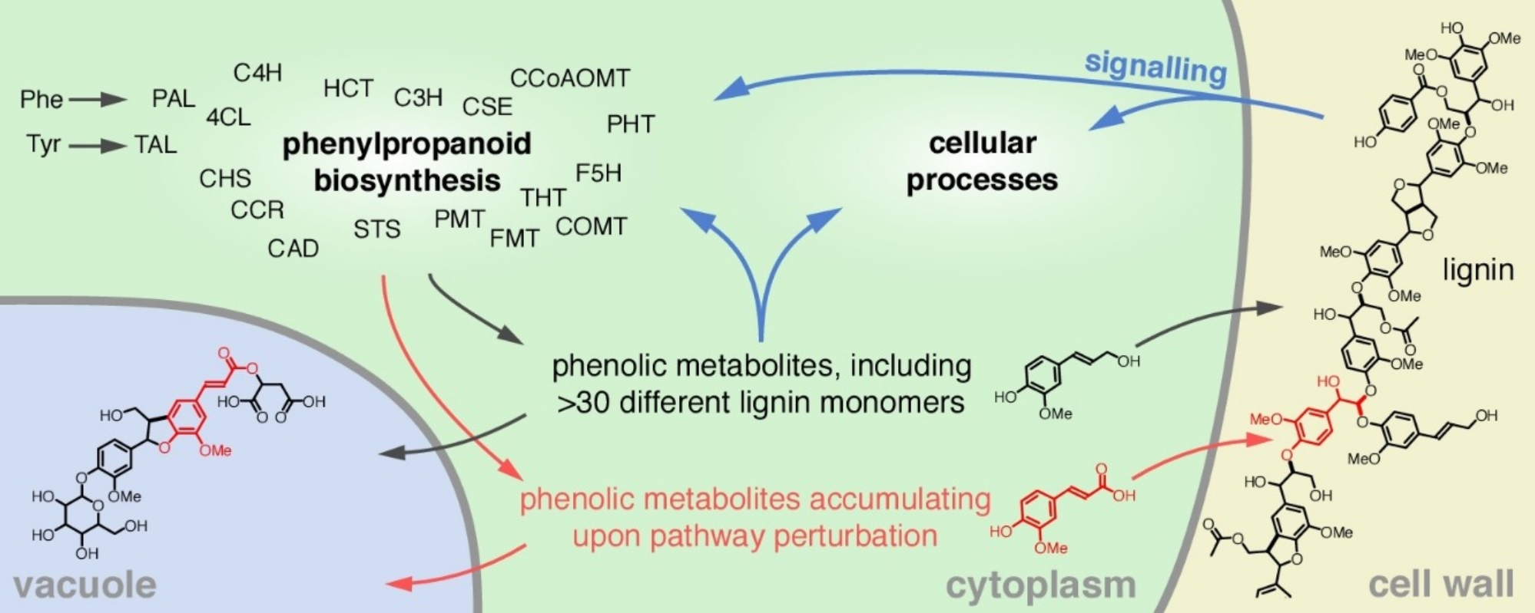
LIGNIN
Vanholme et al., 2019
Notes:
Last, lignin, a polyaromatic compound, is present in high quantities in cell walls in vascular tissues. Synthesis of the highly varied monomers occurs in the cytosol, and lacasses and peroxidases allow lignin polymerisation through oxidation and generation of radicals at the cell wall. Lignin is added last to cell walls of vascular tissues to increase rigidity and hydrophobicity. In this vascular tissues, these cells eventually undergo apoptosis to make hollow vessels to transport water.
Vanholme, R., De Meester, B., Ralph, J., & Boerjan, W. (2019). Lignin biosynthesis and its integration into metabolism. Current Opinion in Biotechnology, 56, 230-239.

Slide 17
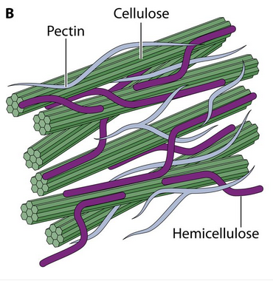
PRIMARY CELL WALL
A very simplified model
Adapted from Rytioja et al., 2014
Notes:
After seeing such a big array of polymers that cell walls can have, one can easily imagine that not all cell walls are the same. Focusing on angiosperms, there are remarkable differences between monocots and eudicots. Without going into differences in polysaccharide substitutions, in the case of eudicots, an abundant matrix of pectin embeds cellulose and hemicelluloses. The most abundant hemicellulose is xyloglucan, and pectin modifications (methylation / demethylation) control cell wall porosity. Instead, monocots have low amounts of pectin, and xylan is the main hemicellulose.
Rytioja, J., Hildén, K., Yuzon, J., Hatakka, A., De Vries, R. P., & Mäkelä, M. R. (2014). Plant-polysaccharide-degrading enzymes from basidiomycetes. Microbiology and Molecular Biology Reviews, 78, 614-649.

Slide 18
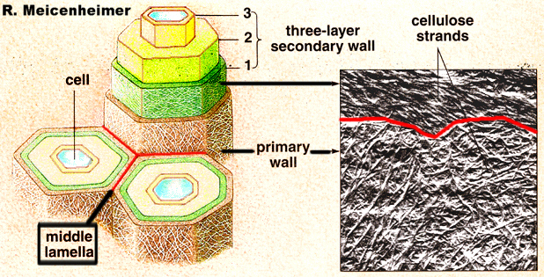
PRIMARY AND SECONDARY CELL WALLS
Notes:
Moreover, different tissues can develop specialised cell walls. All cells form a cell wall during cell growth and development outside their plasma membrane. This is called primary cell wall. However, in the vascular tissue, when cell growth is complete, a thicker cell wall of different composition is developed on the inner face of the primary cell wall. This is called secondary cell wall, and it is composed of three layers of polymers arranged in different orientations. In secondary cell walls, even if other polymers appear in minor amounts, the main components are cellulose, xylan, and lignin. In gymnosperms, however, mannan is the main hemicellulose. Even if the secondary cell wall is present just in the vascular tissue, this actually account for most of the world plant biomass: large trunk, branches, and roots constitute most of trees after all!
This picture also shows the middle lamella, the outermost layer between cells. This middle lamella is particularly rich in pectins.
Image from https://www1.biologie.uni-hamburg.de/b-online/library/webb/BOT311/PlantCellWalls00/PCW00-15.htm (checked on 10/January/2023)

Slide 19
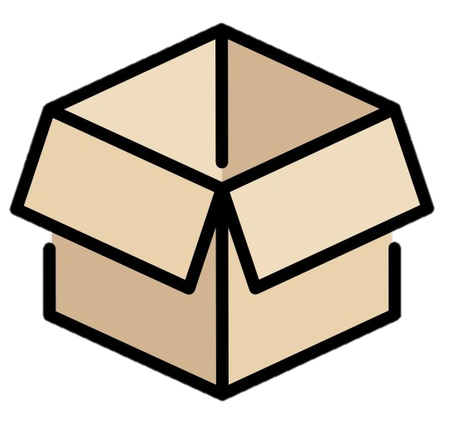
APPLICATIONS
Cotton
Building
material
Biofuels
Cardboard and paper
Wooden furniture
Dietary fibre
Animal feed
Bioplastics
Notes:
I bet you are surrounded by plant cell walls right now! Cell walls constitute wood after all, so you might currently be in a building that, at least, partly used wood as a construction material, or, at least, more likely, you might be surrounded by wooden furniture. Maybe around you there are some notebooks, books, or paper sheets, all coming from processed wood too, or, perhaps, cardboard from a delivery box. Are you wearing any cotton clothes? Then, let me tell you that cotton is pretty much just cellulose (textiles derived from wood are currently being developed too!). In a more indirect way, if you buy food at the supermarket and you read the label about its nutrition facts, you will come across a section called ‘fibre’. This is, again, plant cell wall material, and it is essential to keep a diverse gut microbiota. Research in recent years suggests the importance of our gut microbiota in our physical and mental health. Speaking about food, to obtain meat, animal feed is required, which is cell wall material to a large extent. Still, one could think of even more sophisticated applications, such as degrading agricultural waste to feed microorganisms and produce biofuels, or instead, using cell wall material to produce sustainable bioplastics.

Slide 20
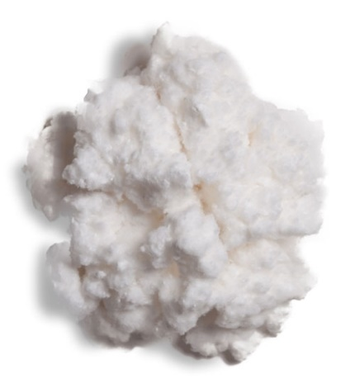
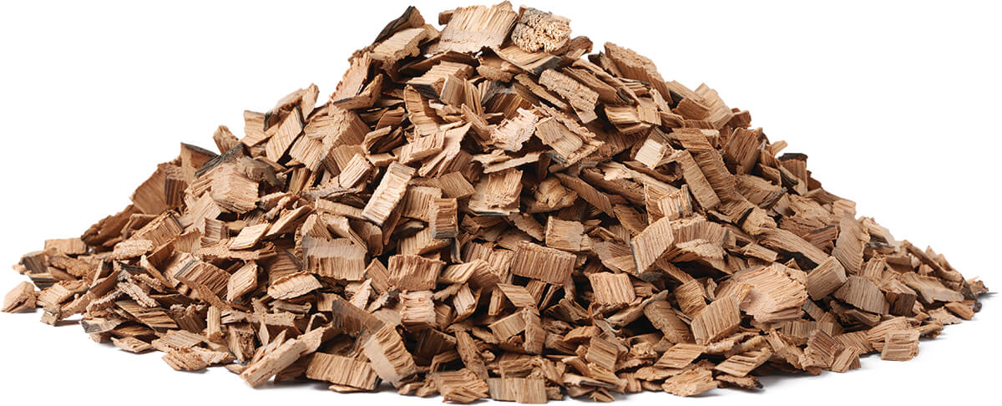
PAPER INDUSTRY
Pressure
NaOH
Heat
Na₂SO₃
Wood
Paper
OH⁻
Phenols
Organochlorines
POLLUTANTS
Notes:
In order to make the most of all those applications (and more to come in the future), we need a very good understanding of the cell wall at all possible levels. Why? Because most of the aforementioned applications are usually hindered by the difficulty to break down the cell wall. After all, if degrading the cell wall were easy, plants would not survive for long in nature. As an example, we mentioned paper, something widespread. However, in order to transform wood into paper, heat, pressure, alkali, and sodium sulphite are required. This process releases big quantities of organochlorines, phenols, and alkali to the environment, which turns the paper industry as one of the most polluting in the world. Without counting all the water required to grow a tree, just to convert wood into a single paper sheet, over a whole litre of water is often required. Nevertheless, this might not need to be like this in the future: we currently have a poor understanding on how to separate the tightly bound cell wall components, but research on the cell wall is promising for the years ahead!

Slide 21
PLANT CELL WALL RESEARCH
Synthesis
How do enzymes control polysaccharide backbone synthesis? Do enzymes synthesising cell wall polymers follow any pattern to add branches?
Notes:
Unfortunately, there are still many of these partners yet to be discovered and characterised, but our knowledge grows daily. Biochemical studies allow researchers to find out what activity enzymes carry out, say, what sugar they add to which polymer and following which pattern (if any at all), whereas structural investigations shed light on the molecular mechanisms that these proteins follow. All this research is more important than what one could think at first: many of the substitutions along hemicellulose backbones that we saw are not crucial for plant survival under optimal conditions. However, some changes can be severely detrimental and render plants dwarf. Nevertheless, new avenues for Biotechnology have already emerged from those subtle changes that do not decrease biomass yield yet result in more degradable material. Still, for some applications, rather than weaker cell walls, stronger or more flexible ones might be preferred (imagine making wood skyscrapers!). Maybe, someday, we will be growing genetically engineered trees for very specific applications.

Slide 22
PLANT CELL WALL RESEARCH
Synthesis
How do enzymes control polysaccharide backbone synthesis? Do enzymes synthesising cell wall polymers follow any pattern to add branches?
Degradation
What patterns do cell wall degrading enzymes recognise? What can we learn about complex polysaccharide patterns using degrading enzymes with known activities?
Notes:
For those applications that first require cell wall breakdown, another way to tackle this issue is to improve our current methods to degrade the cell wall. Big progress is currently being made in terms of sustainability by replacing harsh chemicals by enzymes. In the same fashion as many enzymes are required to generate that wide diversity of cell wall polymers, many enzymes are also required to remove that broad range of sugar bonds. Thankfully, nature has already developed many of those mechanisms, and metagenomic studies have recently proven particularly useful to discover more and more enzyme activities where wood or other cell wall materials are naturally degraded. Thus, combination of as many different enzyme activities as possible often enhances cell wall loosening and degradation.

Slide 23
PLANT CELL WALL RESEARCH
Synthesis
How do enzymes control polysaccharide backbone synthesis? Do enzymes synthesising cell wall polymers follow any pattern to add branches?
Degradation
What patterns do cell wall degrading enzymes recognise? What can we learn about complex polysaccharide patterns using degrading enzymes with known activities?
Assembly
How do hemicelluloses bind cellulose?
How do branches in hemicelluloses influence that binding?
Notes:
The last cell wall research topic that we mentioned was assembly. Earlier in this document, we quickly mentioned that cellulose synthesis and hemicellulose deposition are somehow finely coordinated. Not only is it necessary to understand the composition of hemicelluloses or, for instance, the pattern that their substitutions might follow, but also how these subtle modifications influence the interaction between the cell wall polymers. This field will then hint which details in cell wall synthesis are worth modifying for specific applications, or which enzymes are most required for a cost effective cell wall degradation. Don’t be afraid and join the scientific community on our mission to build a better world together!

Slide 24
THANKS FOR READING!

